Slide 1
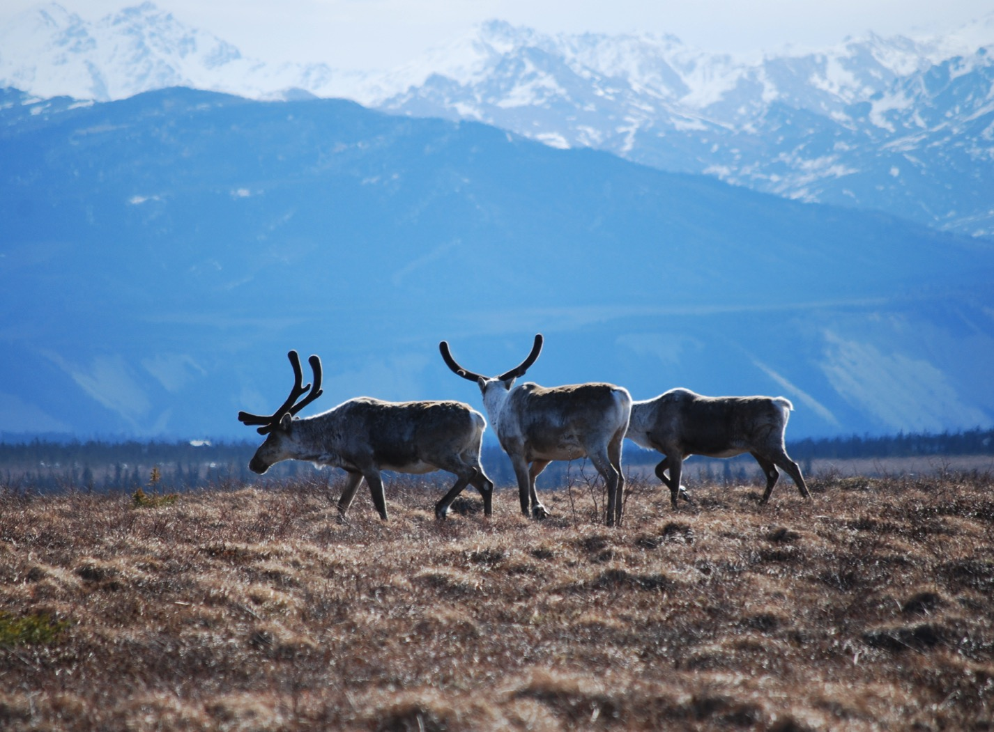
Arctic Boreal Vulnerability Experiment (ABoVE)
2017 ABoVE Airborne Campaign
19 July 2017 (DOY 200)
AirSWOT/Ka-SPAR:
Sag River Joint Ground-Air Survey
Charles Miller, Deputy Science Lead
Jet Propulsion Laboratory, California Institute of Technology
and the ABoVE Science Team For Hank Margolis, Eric Kasichke, Bruce Tagg
NASA HQ
2017

Slide 2
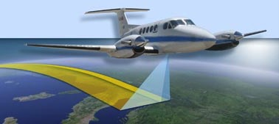
19 July 2017/DOY 200 Sag River Joint Ground-Air Survey
Daily Status:
N801NA AirSWOT ABoVE CAMPAIGN (CANADA / ALASKA)
REPORT DATE: 19 July 2017
Current Status of Aircraft: GREEN
Current Status of Radar: Yellow Failed receiver (socket 5)
Current Status of Camera: Yellow Replacement camera
Current Status of Crew: GREEN
Current Deployment Location: Fairbanks International Airport (PAFA)
Crew: Salling, Posada, Chao, Soto
Science Coordinators: T Pavelsky, C Rains
Science Lead: L Smith
Project Manager: Y Lou

Slide 3
19 July 2017/DOY 200 Sag River Joint Ground-Air Survey
Daily Summary:
AirSWOT team took off around noon today and flew 6 lines in PLAN PAVE_0072.
Camera & KaSPAR worked well.
There were 364 pictures taken during the mission.
Mostly overcast except the line PAVE10_179

Slide 4
19 July 2017/DOY 200 72-Hour Look Ahead
All plans weather dependent
Wednesday 19 July 2017 (DOY 200):
Field team targeting joint ground-airborne acquisitions along Sagawon River (North Slope)
Thursday 20 July 2017 (DOY 201):
TBD
Friday 21 July 2017 (DOY 202):
Backup day for joint ground-airborne acquisitions along Sagawon River (North Slope)

Slide 5
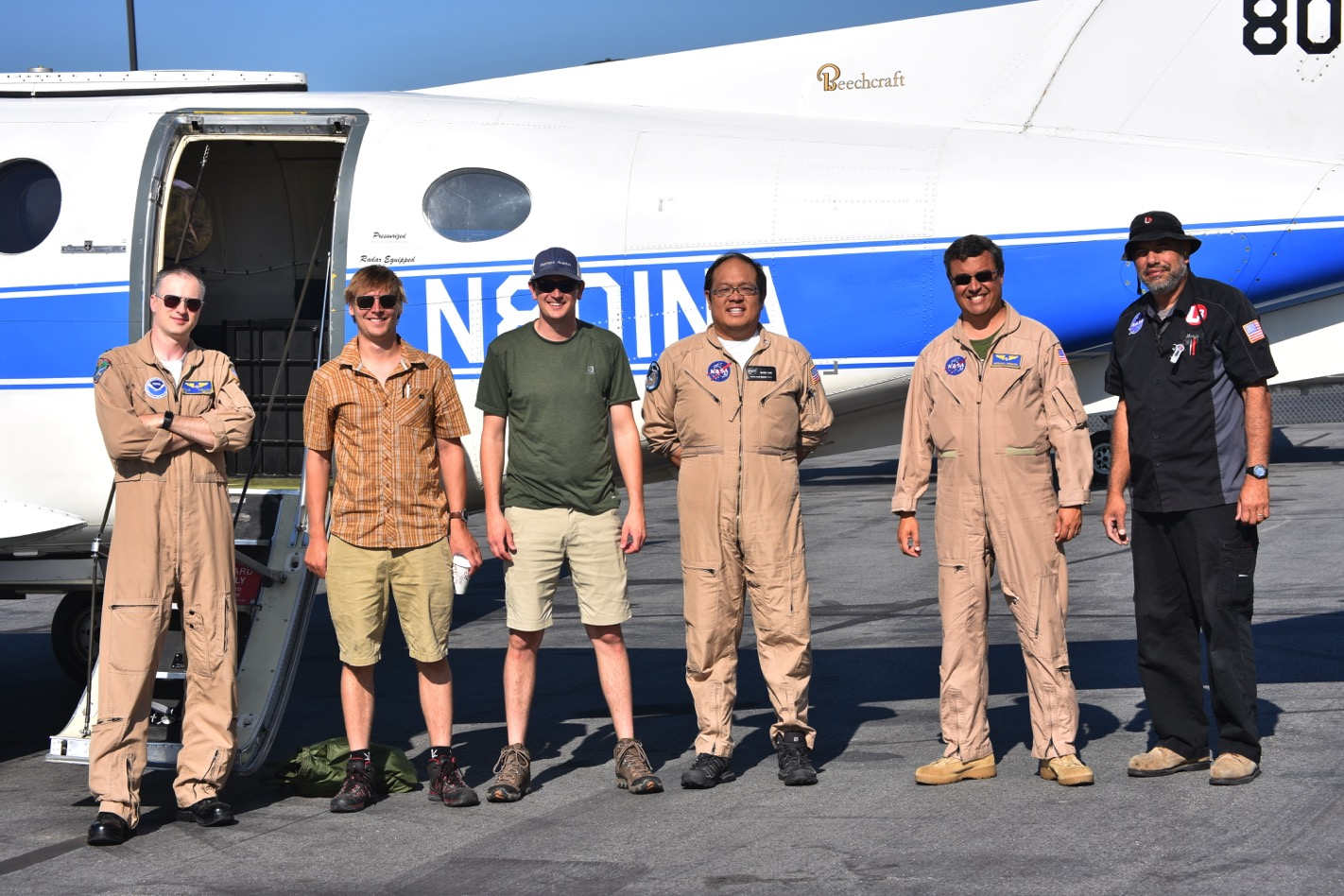
Ka-SPAR / NASA 801 and ArctiC-C / N617DH teams

Slide 6
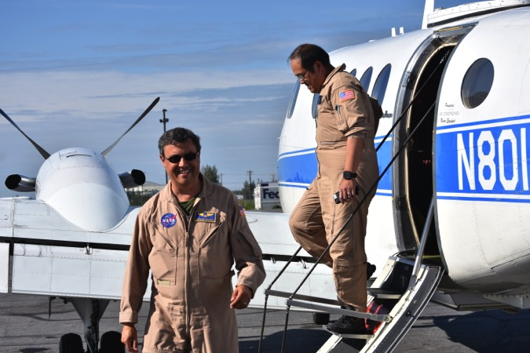
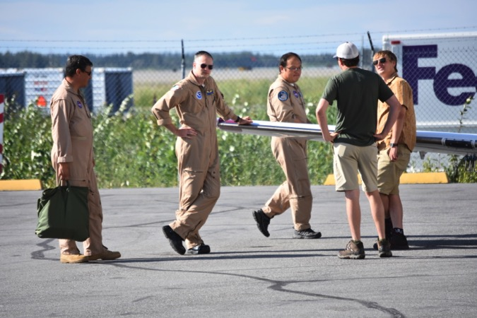
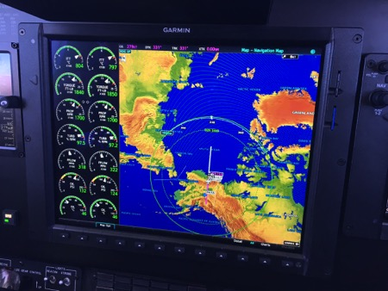
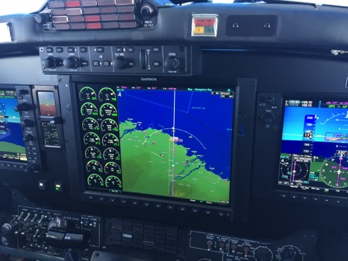
19 July 2017/DOY 200 Sag River Joint Ground-Air Survey

Slide 7
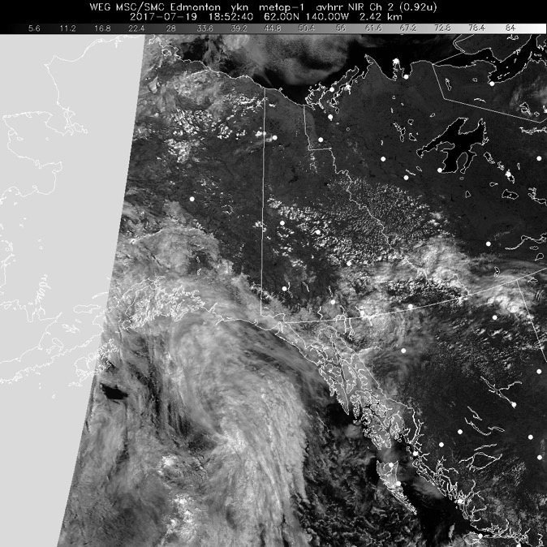
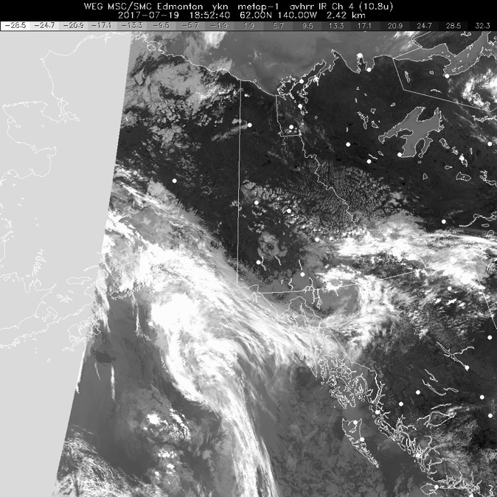
19 July 2017/DOY 200 Sag River Joint Ground-Air Survey
HRPT Visible
1852Z
HRPT IR
1852Z
Clear to partly cloudy over the Sag River & eastern North Slope

Slide 8
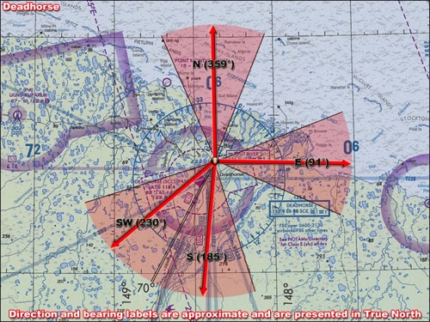
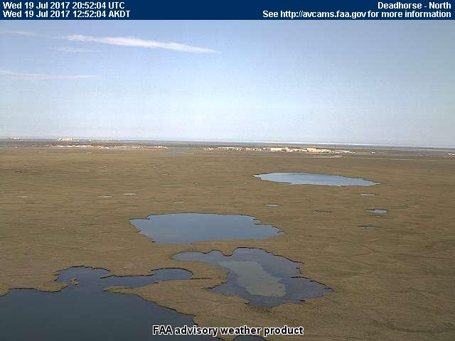
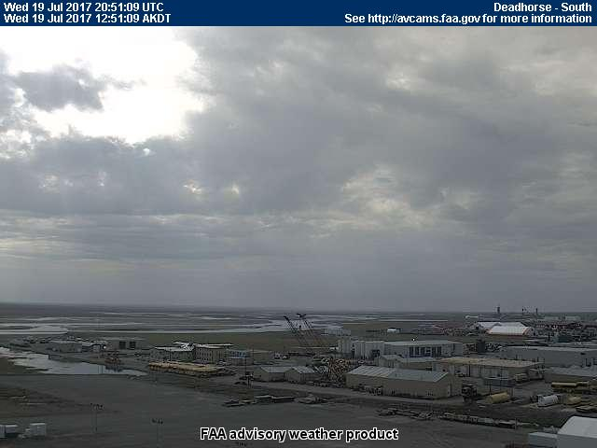
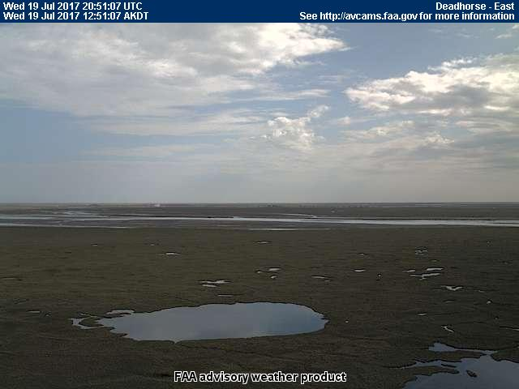
13 July 2017/DOY 194 Deadhorse – Toolik Lake
Deadhorse Airport (PASC)
North
Southwest
South
East
Notes:
AVCAM sky pictures from the Deadhorse Airport (PASC) at 1325 AKDT/2125 UTC showing extreme clear conditions and the sectional coverage of each camera. The SW camera was not functioning
See http://avcams.faa.gov/ for an interactive map of Alaska aviation cameras

Slide 9
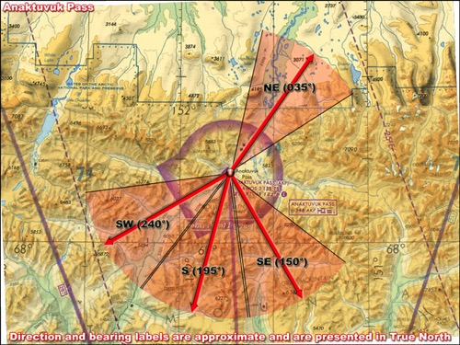
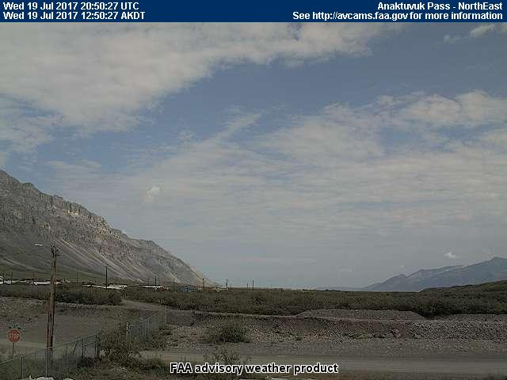
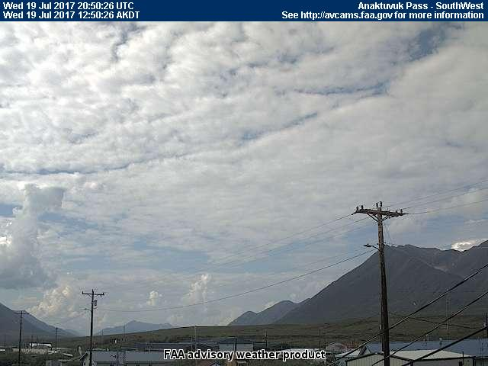
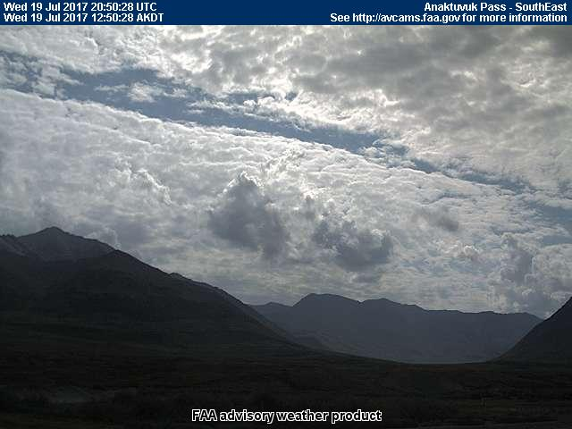
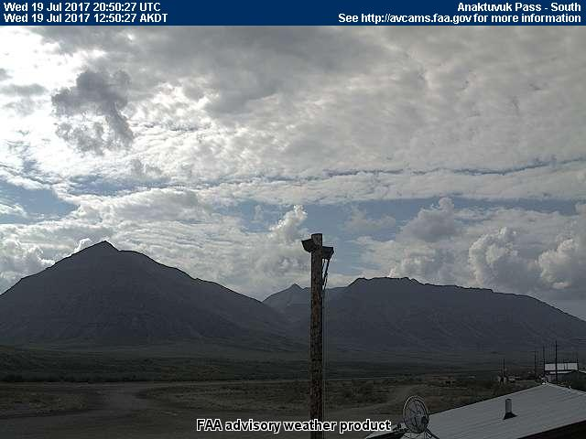
13 July 2017/DOY 194 Deadhorse – Toolik Lake
Anaktuvuk Pass (just south of Toolik Lake)
NORTH
Stevens Village
Northeast
Southwest
South
Southeast
Notes:
AVCAM sky pictures from the Anaktuvuk Pass air strip at 1337 AKDT/2137 UTC showing extreme clear conditions and the sectional coverage of each camera. The SW camera was not functioning
See http://avcams.faa.gov/ for an interactive map of Alaska aviation cameras

Slide 10
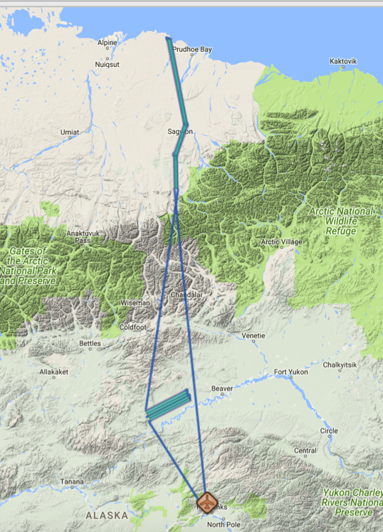
19 July 2017/DOY 200 Sag River Joint Ground-Air Survey
Flight Plan Report: pavelky_0072 (YF West Sag River May 31)
https://flightplanning.jpl.nasa.gov/cgi-bin/report.pl?planID=pavelky_0072#summary
Flight plan & acquisition segments
Data Acquisitions:
Line 1 pave01_063aa
Line 2 pave02_243aa
Line 3 pave03_063aa
Line 4 pave04_243aa
Line 5 pave07_359aa
Line 6 pave05_019aa
Line 7 pave06_349aa
Line 8 pave08_169aa
Line 9 pave09_199aa
Line 10 pave10_179aa
Lines 1-4 not acquired on 7/19/17
pave06_349aa
pave08_169aa
pave05_019aa
pave09_199aa
pave07_359aa
pave10_179aa
pave01_063aa
pave02_243aa
pave03_063aa
pave0$_243aa

Slide 11
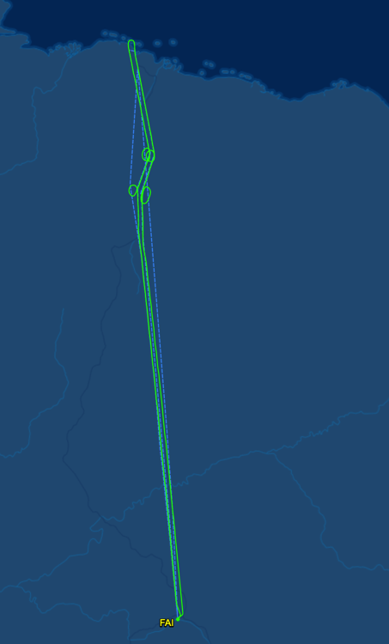
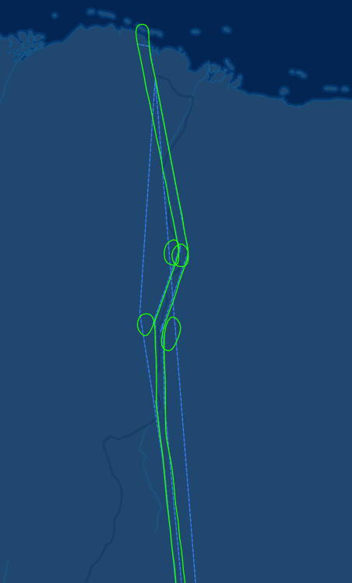
19 July 2017/DOY 200 Sag River Joint Ground-Air Survey
Flight Plan Report: pavelky_0072 (YF West Sag River May 31)
https://flightplanning.jpl.nasa.gov/cgi-bin/report.pl?planID=pavelky_0072#summary
Deadhorse AK (PASC)
Deadhorse AK (PASC)
Data Acquisitions:
Line 1 pave01_063aa
Line 2 pave02_243aa
Line 3 pave03_063aa
Line 4 pave04_243aa
Line 5 pave07_359aa
Line 6 pave05_019aa
Line 7 pave06_349aa
Line 8 pave08_169aa
Line 9 pave09_199aa
Line 10 pave10_179aa
Lines 1-4 not acquired on 7/19/17
pave06_349aa
pave08_169aa
pave05_019aa
pave09_199aa
pave07_359aa
pave10_179aa
As-flown lines & acquisition segments
Fairbanks AK
(PAFA)
Sag River
Area Detail

Slide 12
19 July 2017/DOY 200 Sag River Joint Ground-Air Survey
Quick-look products to be generated

